Slide 1

Mtivity Client Support System
Quick start guide

Slide 2
Mtivity Client Support System
We are very pleased to announce the launch of a new Client Support System for Mtivity. The new Client Support System will provide you with more support than ever before, enhancing your use of Mtivity on a daily basis.
Key Benefits of the new Client Support System:
User Profiles – Create your own profile and track requests, view client specific information and submit requests with ease.
Online Request Submitting – By completing the form online, with a few pieces of specific information we will be able to greater assist you.
Contact – support requests will be answered through the system, but also answers will generate an email to you so you won’t miss out if you don’t log on.
News – your home page will show news items and updates about Mtivity.
Forums – Announcements, FAQs, Guides and Documents and client specific areas. You will be able to easily find answers to your questions here. You can also participate in some forums and help grow the information that will assist all clients.
We will still be able to deal with support requests via email, telephone and Skype – but every request will be logged into the Support System to give Mtivity Support Staff enhanced management of all support requests.

Slide 3
How to contact Mtivity Support
Primary Support Desk:
www.mtivity.com/support
This is our new Client Support System, and we would greatly appreciate you trying this method before any other to solve your query, problem or bug.
Other methods to contact Mtivity Support:
Email:
support@mtivity.com
This email address will direct all emails to our Client Support System, where they will be converted into a Request. However, we can help you more if you directly go to our system first, as you will be able to provide more specific details, which can enable us to solve your case quicker and more effectively.
Skype:
Mtivity.support
You can IM or call us on Skype.
Tel:
UK Support Desk: +44 (0)333 666 1890 (M-F, 9am – 5.30pm GMT)
US Support Desk: +1 (585) 200 3151 (M-F, 9am – 5.30pm EST)

Slide 4
First time user: Setting up a profile on mtivity.com/support

Slide 5
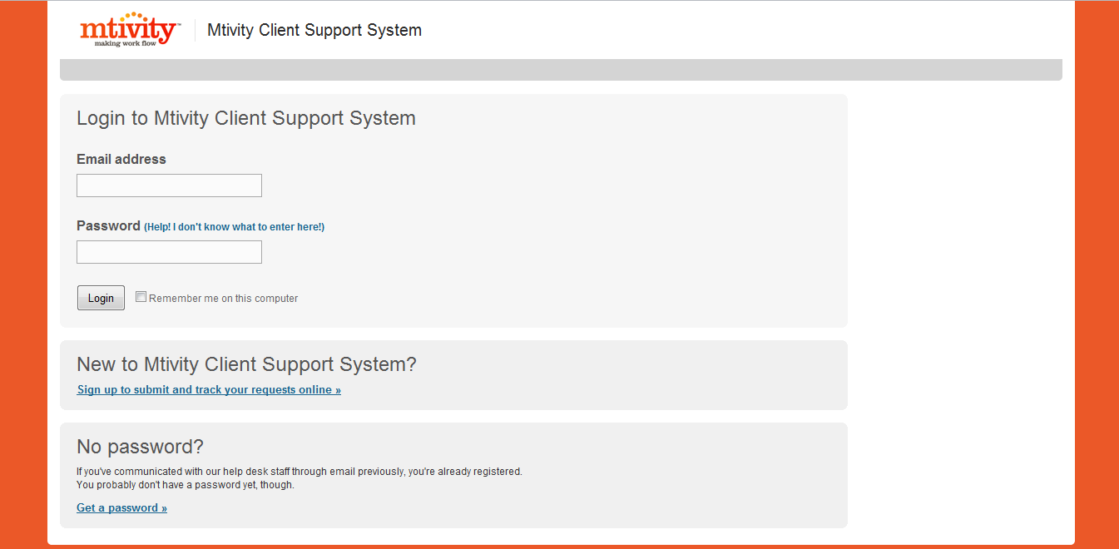
Quick Start Guide for www.mtivity.com/support
First Time User:
Go to www.mtivity.com/support, as a first time user you will arrive at this page. As you have not used this system before you will not have a profile yet (your Mtivity login will not work) and will be asked to create one.
Click here to set up your profile – this is a very quick and easy process and only needs to be done once.

Slide 6
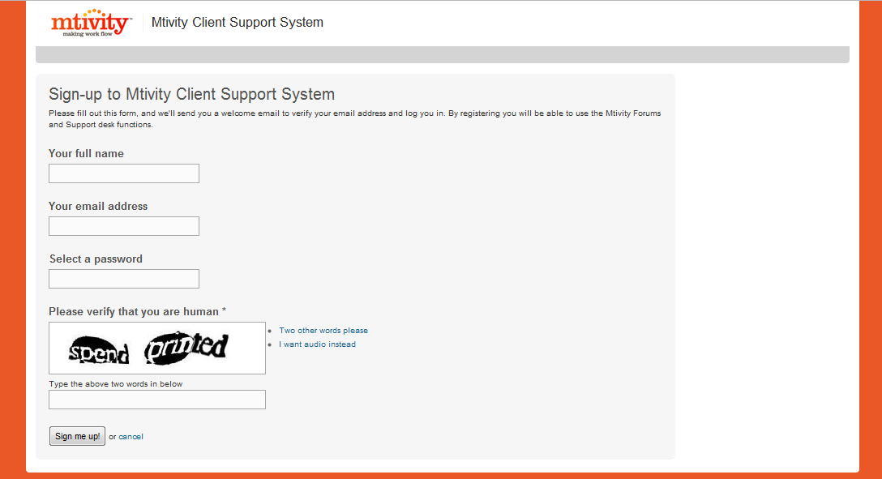
Creating your profile for Mtivity Support
Sign up is quick and easy, no long form to fill in. Simply enter your name, email address, a password and then type the words you see for an extra security measure.
Click Sign me up! To complete the registration process.

Slide 7
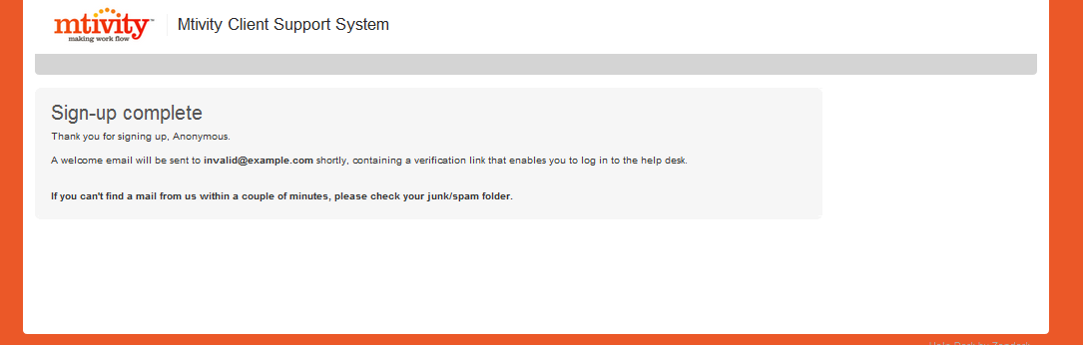
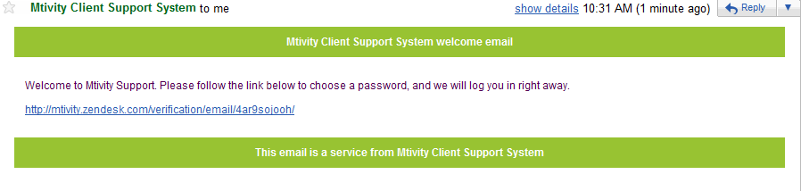
Creating your profile for Mtivity Support
You will then see a notice to let you know this part of your sign up is complete.
Before you can use the system, you will need to verify your email address. Please check your email, and you should have a message from us (Check Junk / Spam if no email after a few minutes), then click on the link.
Follow this link to verify your profile.

Slide 8
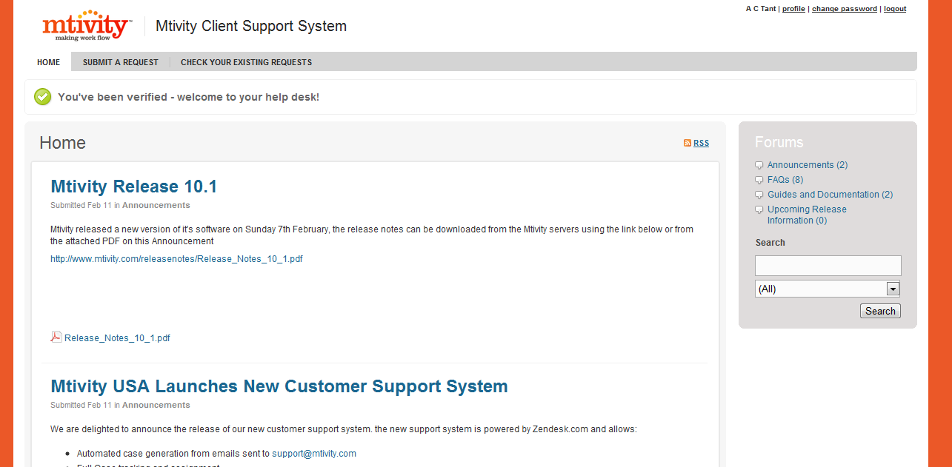
Your Mtivity Client Support System
This is your home page, this is the page you will get to when you next login. Make sure you save your email and password somewhere safe!

Slide 9
Submitting A Request to Mtivity Support

Slide 10
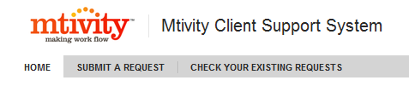
How to use Mtivity Client Support System.
Now we will look at some of the functions of the Mtivity Client Support System.
How to log a support call
In the system, we refer to support calls, reporting of bugs, questions and more as Requests.
The Navigation Bar appears at the top of all your pages and provides you links to the main purpose of the system: Submitting and Checking Requests.
By Selecting Submit A Request, you will be able to fill in details and information on your Request.

Slide 11
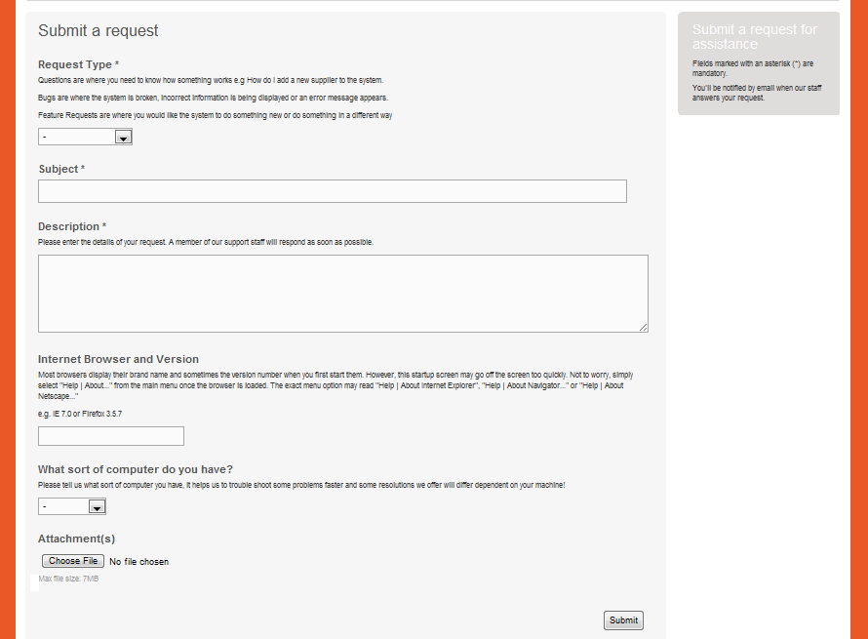
Submitting A Request
Select your Request type. We have 3 types: Question, Bug and Feature Request.
Enter the subject of your request, Keep this part simple.
The detailed description needs to be completed here. Please be accurate and provide all the details possible.
Depending on the request, by telling us a little about your browser and computer, we may be able to solve a request faster for you.
Upload any files that need to be sent with your request. Screenshots entered into a Word Doc are preferred.
Last Step: SUBMIT.

Slide 12
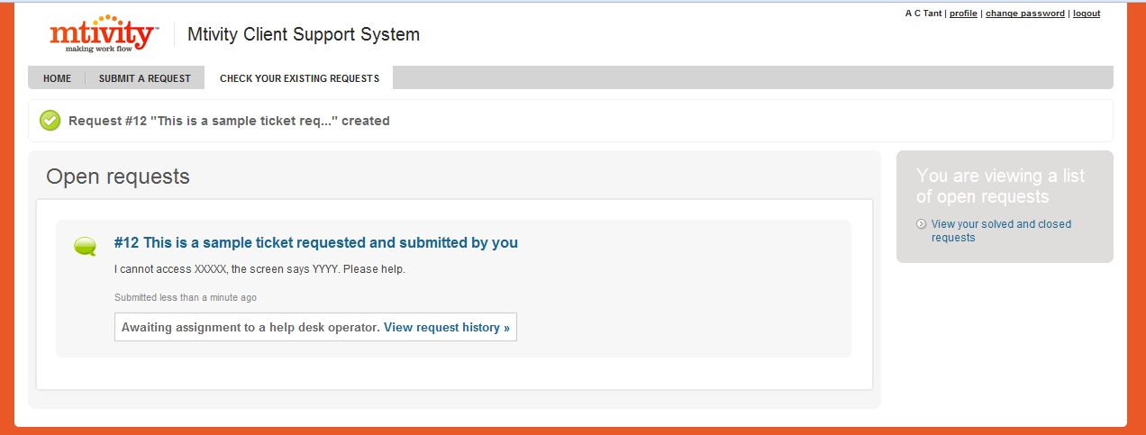
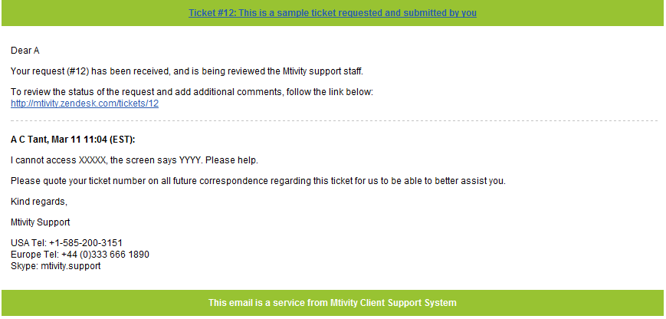
Submitting A Request
Now you have submitted your request, your screen moves to Check Your Existing Requests.
You will also receive an email with the Request details.

Slide 13
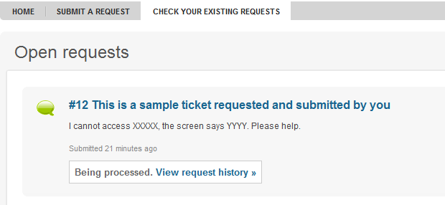
Submitting A Request
The Mtivity Support Staff will now receive your request and assign it to a department for action. Response times depend on your SLA, but we will answer all requests as soon as possible.
Once the Request has been assigned, your Existing Requests screen updated.
This function will allow you to add to this specific request or mark it as solved. This can be used if the problem does not now need attention, or if something else occurs within a short time frame that is related.

Slide 14
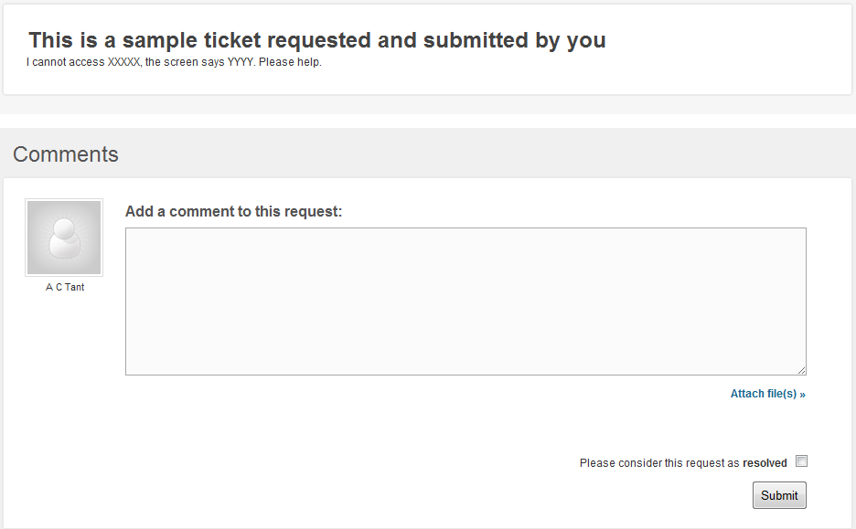
Submitting A Request
Linking from your Exiting Request page, you can access any specific Request and History.
This is the page you will see for Viewing A Request History
Additional comments
If it no longer needs attention, i.e the problem is solved, please check here.
Send Files
Click SUBMIT to send on this additional information.

Slide 15
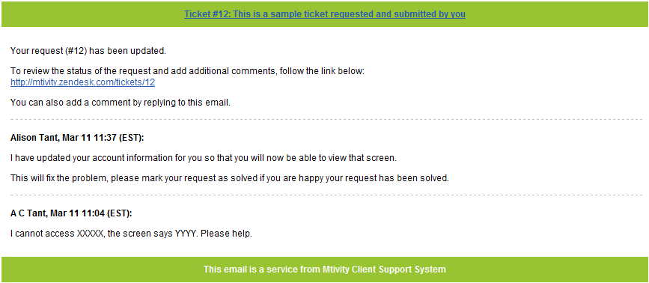
Response to your Request
Once a member of our Support Staff has responded to your request, you will receive an email with the details of the response.
Follow the link to mtivity.com/support to view your request and the response.
The response will be here
Your request will be here.

Slide 16
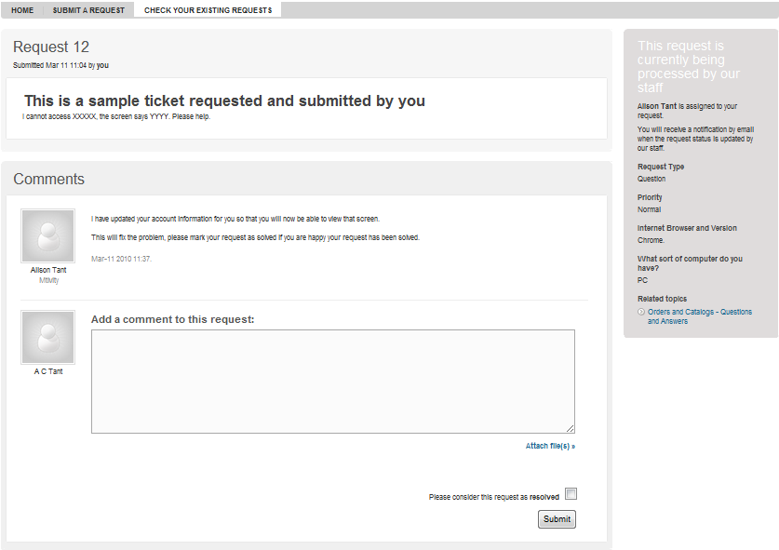
Response to your Request
By clicking on the link in your email, you will straight to your Request. You can also check your Request progress directly though the system. Select Check Existing tickets > Request History.
For your information, an overview of the request will be here.
The response from our Support Desk is here.
If you are happy with the solution and the problem is fixed, check this Resolved box.
If you wish to comment further, please do so here.
Finally, click SUBMIT.

Slide 17
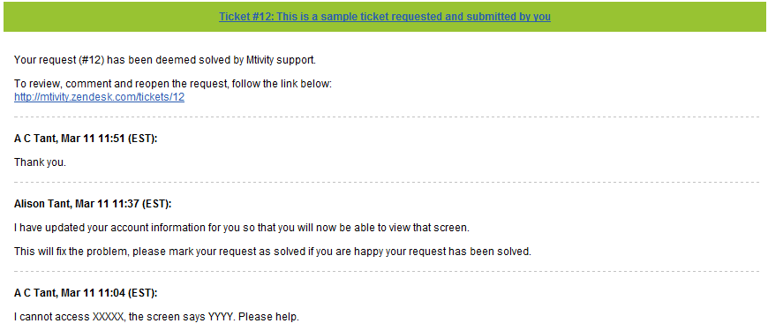
Completion of your Request
If your request has been resolved Mtivity Support will be notified and your request closed. You will receive an email to this effect.
Email to state your request has been solved.
If your request was not resolved, the process will continue in that you will receive an email when Mtivity Support have responded to your additional comments.
Please only use additional comments for problems with this specific request. If you have another issue, please log a new request.
You can have multiple requests at any one time, and these can all be viewed on your profile though Exiting Requests tab on the Navigation bar

Slide 18
Mtivity Forums

Slide 19
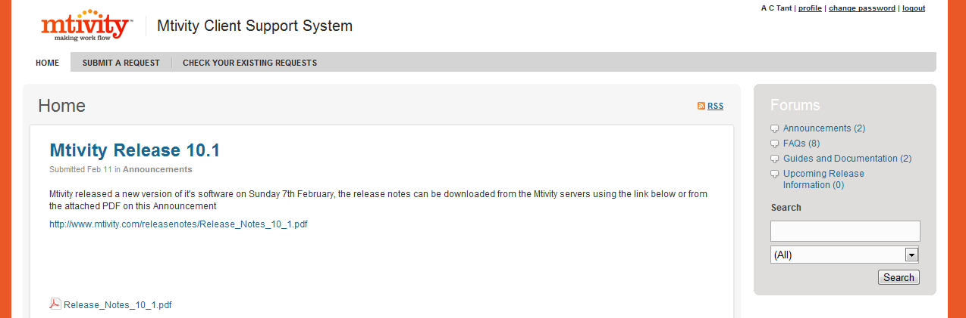
Mtivity Forums
As part of our Client Support System, we now also offer interactive forum for all our clients. These are being populated with Frequently Asked Questions, Guides & Documentation as well as updates on Mtivity.
As a user of Mtivity and Mtivity Support, you will have access to these on www.mtivity.com/support We also have client specific forums that you will only see if you are that client or group.
We hope these forums will help assist our client base by giving you ease of access to information previously only available through Mtivity Support or your administrator.
Your Home Page will show you News articles and updates that we wish to bring quickly to your attention, but it will be worth looking also in our Forums, accessed from your Home Page.
Clicking on FORUMS will take you to the main Forum page. Or select a Forum listed to go directly to that one.
You can also use this search function to search within all (or selected) forums.

Slide 20
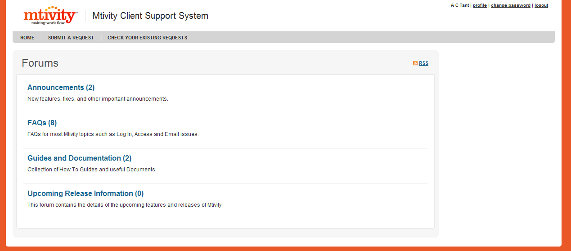
Mtivity Forums
Forums will be populated by Mtivity, but also by Users. It will be a developing knowledge bank for the use of Mtivity.
Click on the Forum title to access the topics. The number here shows how many topics are currently in this forum.

Slide 21
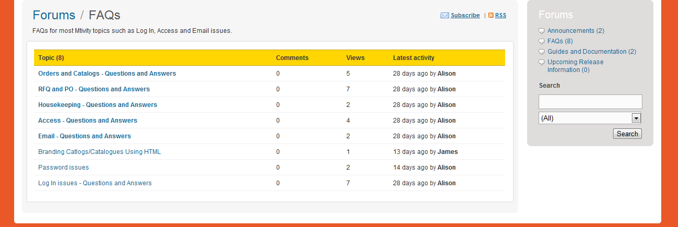
Mtivity Forums
You will see a list of topics in the Forum, number of comments, view and the latest activity.
Use the crumb trail to get back to Forum home.
Simply click on the topic to view. From there, you can add comments – such as another FAQ in that Topic that you have the answer too and you think might be helpful to other Mtivity users.

Slide 22
Editing Your Information

Slide 23

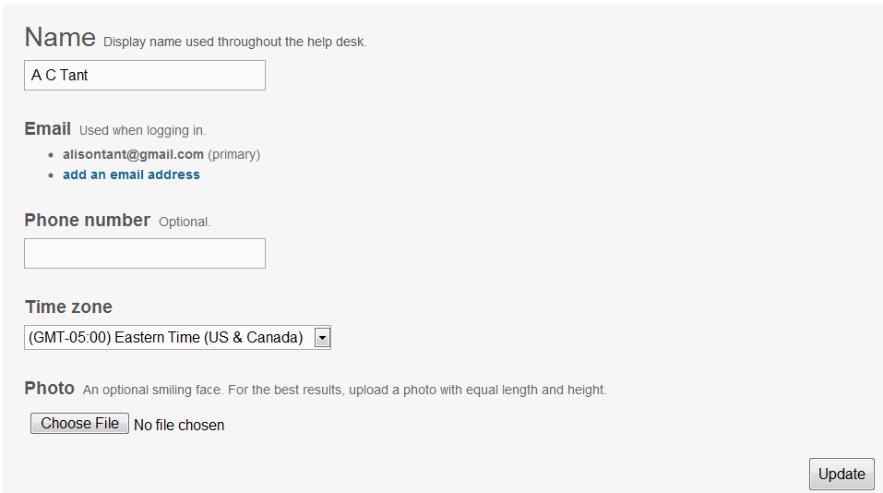
Editing your information.
At the top right hand side of every screen on mtivity.com/support, you will see your name and 3 links – Profile, Change Password and Logout.
Profile will allow you to add details to your account.
Change your name
Add an additional email address and phone number
Set your time zone
Be sure to click UPDATE to save your changes.
And personalize your profile with a Photo! This will appear next to your requests, where you currently see a gray image and your name.

Slide 24
We hope you find our Mtivity Client Support System easy to use and see the many benefits of this upgrade.
Please do let us have your feedback or any questions you have – we’d love to hear from you.
On behalf of all at Mtivity, we thank you for adopting this change and we are pleased that this system will allow us to manage your requests with high efficiency.

